Slide 1

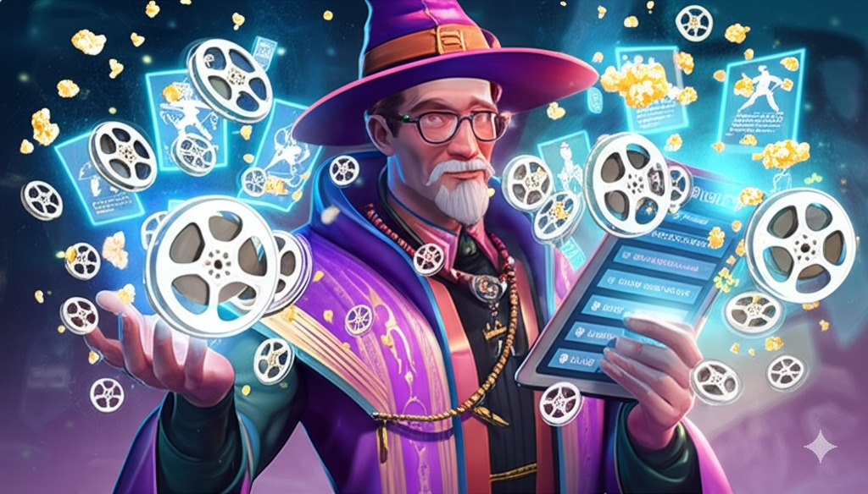
Watchlist Wizard: movie Database Adrian Todd CPSC 3660 Final Project

Slide 2



AGENDA
INTRODUCTION/System Overview
Conceptual and Logical Design
Implementation
SQL Queries Demo
App Demo
Challenges
Future Improvements

Slide 3
Project Goals:
Design a robust and normalized relational database schema for movie data.
Implement the schema using MySQL
Populate the database using data scraped from a real-world source. In this case I used IMDb
Demonstrate effective retrieval and manipulation using various SQL queries
Overarching goal was to gain experience designing and implementing a functional relational database that I could integrate into a web application

Slide 4

System Overview
Web Crawler:
Uses a BFS to scrape movie and people links from IMDb
Built with Python:
Main Libraries used:
mysql-connector-python
Used to connect to and query DB
requests
HTTP library
urllib
BeautifulSoup
Data structure library for representing parsed HTML
Seleneium
WebDriver to control the browser
nltk
Open-source library for Natural Language processing.
MySQL Database:
Implementation of relational schema design
Central Repository storing structured information scraped from IMDb enabling efficient querying for the Backend API
Backend:
Built using Python and the Flask web application framework
Connects to MySQL database
Responds to API endpoint requests
Frontend:
Next.js frontend implemented with React and Typescript
Allows for user interaction

Slide 5

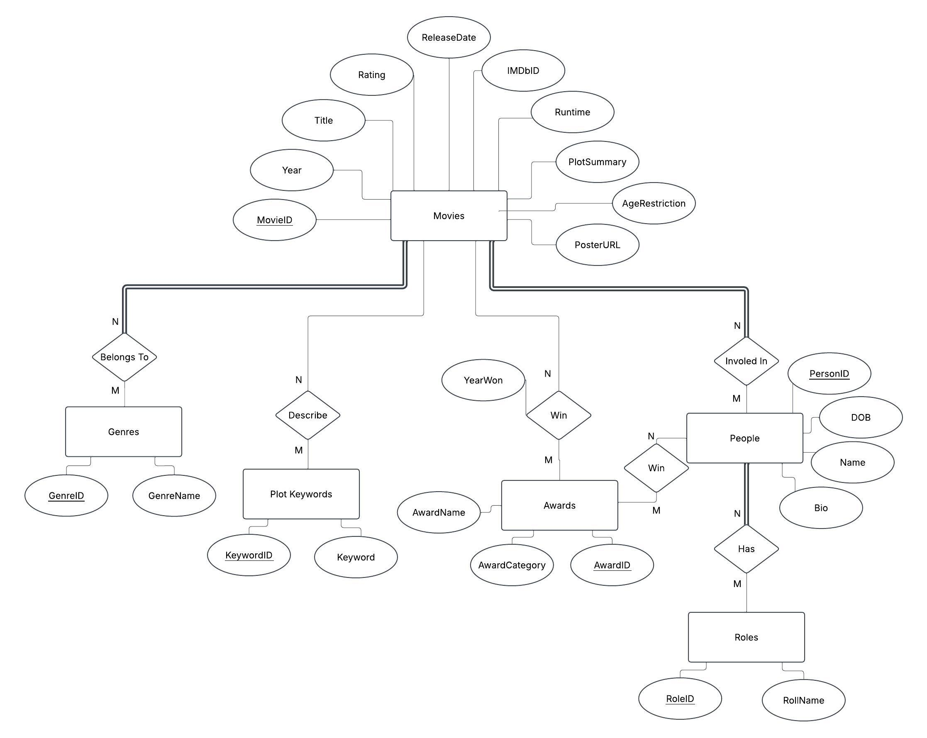
Enhanced Entity
Relationship Diagram:

Slide 6
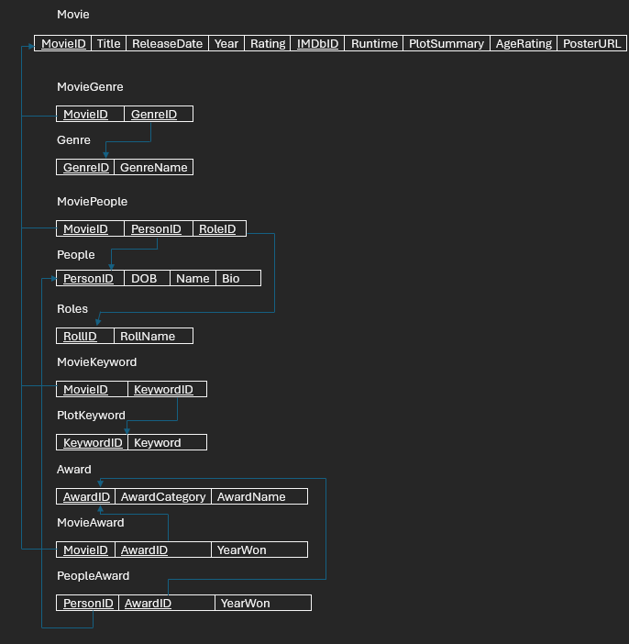

Slide 7
SQL Queries Demo

Slide 8
Web App Demo

Slide 9
Challenges & Future Improvements
Web Scraping Data:
Initial sleuthing through IMDb’s HTML to find the right elements and classes containing the data I wanted to extract.
Handling Dynamically loaded content.
Learning about the limits placed on web scraping. robots.txt and adding delays to limit how fast my web scraper was submitting requests.
Structure of Movie Awards on IMDb:
So many different types of awards so the data was going to be to time consuming to parse and scrape.
Implement User accounts and a recommendation algorithm:
Add user accounts system so they can keep track of watched movies, create a watchlist, and rate movies they have watched.
Add TV Show Data
Expand the depth of web crawling.

Slide 10

Conclusion
Successfully designed and implemented a relational database for movie data.
Demonstrated ability to populate the database via web scraping.
Effectively utitlized various SQL queries to retrieve and manipulate data.
The robust database provides a solid foundation for further building out this application.
And.. That’s a wrap for this presentation.

